Slide 1
Web Testing
Software Testing

Slide 2
Objectives
Apply common testing techniques to web testing including:
  Testing web pages with black-box techniques
  Testing web pages with white-box techniques
  Configuration and compatibility testing
  Usability testing
  Web testing tools

Slide 3
Web Testing
Web testing is a really difficult problem
  A web applications can be as simple as displaying some text and graphics or as complex as tens of thousands lines of code.
  Web applications can be accessed publicly and face many kinds of attacks.
  More and more technologies are designed to support web applications.
ƒ How to test a web application
  Logically, web applications can be divided into client-side and server-side.
  The testing of the client-side is made up of web pages that focus more attention to the display information, either statically or dynamically.
  Server-side testing focuses more attention on the performance and security, as well as the function processes on the server

Slide 4
Web Page Fundamentals
What makes up a web page?
  In general, a web page is made up of static contents, dynamic contents, or both.
ƒ When testing a web application:
  At first glance, when testing a website you may think about the following questions:
  1. What would you test?
  2. What would you choose not to test?
  3. Which kind of testing techniques can you apply?
ƒ What would you test?
  Possible web page features:
  Text of different sizes, fonts and colors
  ƒ Graphics and photos
  ƒ Hyperlinked text and graphics

Slide 5
Web Page Fundamentals -2
What would you test?
  Possible web page features:
  Rotating advertisements
  Text that has drop-down selection boxes
  Fields in which users can enter data
  Customizable layout
  Customizable content
  Dynamic drop-down selection boxes
  Dynamically changing text
  Dynamic layout and optional information based on screen resolution
  Compatibility with different web browsers, browser versions and hardware and software platforms

Slide 6
Web Page Fundamentals
ƒ What would you test?
  Possible web page features:
  Lots of hidden formatting, tagging and embedded information.
  Embedded applications running on the client side or the server side.
ƒ Which kind of testing techniques can you apply?
  In summary, all the testing techniques such as black-box testing and white-box testing that have been introduced in the previous slides can be used to test web applications. The key point is, those applied techniques should be based on your test requirements.

Slide 7
Test Web Page Using Black-box Method
Testing the text
  Text is the most common content of a web page.
  To test the text, besides the testing techniques introduced in documentation testing in earlier lectures, you should:
    ƒ Check the spelling.
    ƒ Check the terminology, content and subject matter.
    ƒ Check if there is information that may become outdated.
    Check if the contact information such as email address, phone numbers or postal address is correct.
    Check that copyright notices are correct and dated appropriately.
    Check if the title is correct and the default listing when you add the page to your favorites or bookmarks.
    Check the ALT text.
    Check text layout by resizing the browser window to be very small or very large.

Slide 8
Test Web Page Using Black-box Method
Testing the hyperlinks
  Hyperlinks are tied to another web page, text or graphics.
  To test the hyperlinks, you should:
    Check each link to make sure that it jumps to the correct destination and opens in the correct window.
    Make sure that hyperlinks are obvious.
      Text links are underlined and the mouse pointer should change when it’s over any kind of hyperlinks.
      If the link opens an email message, you should make sure it works correctly.
  Look for orphan pages which can’t be accessed through a hyperlink.

Slide 9
Test Web Page Using Black-box Method
Testing the graphics
  To test the graphics on the web page, you may consider the following:
    Do all graphics load and display properly?
     If a graphic can’t be loaded onto a web page, has an error been put in its location?
     Are text and graphics intermixed on the page when resizing the browser’s window?
     How’s the performance of loading the page?
     What will happen if the connection is too slow?

Slide 10
Test Web Page Using Black-box Method
Testing the forms
  Forms are the text boxes, list boxes and other fields for entering or selecting information on a web page.
  To test the forms on the web page, you may consider the following:
    Are the website’s form fields positioned properly?
    Are the fields the correct size?
    Do they accept the correct data and reject the wrong data?
    Is there proper confirmation when you finish inputting?
    Are optional fields truly optional and the required ones truly required?
     What will happen if you enter random contents?

Slide 11
Test Web Page Using Black-box Method
Testing other elements, such as:
  Hit counter
  Changing advertisements
  Internal searches and so on
ƒ You may consider:
  Does it have its own states?
  Does it handle data?
  Could it have ranges or boundaries?
  What test cases apply and how should they be equivalence classed?
  Test Web Page Using Black-box Method

Slide 12
Test Web Page Using Gray-box Method
Definition
  Gray-box is a mixture of black-box and white-box testing that tests the software as black-box, but can supplement the work by taking a peek at what makes the software work.
Test web page using the gray-box method
  Web pages lend themselves nicely to gray-box testing because most web pages are built with HTML, which is a kind of markup language that doesn’t execute or run. HTML just determines how text and graphics appear on the screen.
• It is helpful for testers to study the techniques of HTML by examining the HTML documentation, as you may find defects that lie in your web page.

Slide 13
Test Web Page Using White-box Method
Overview
  In order to make web pages more attractive, applications can be embedded into the web page by programming various kinds of languages such as Java, JavaScript, Perl, CGI.
  This problem follows the rules that normal software testing does, that is, they should be tested using either black-box or white-box methods.
 The following are tied to white-box testing.
• Dynamic content:
 Client-side: embedded with the HTML and execute at the client side.
 Sever-side: located on and executed at the server side

Slide 14
Test Web Page Using White-box Method
The following are tied to white-box testing:
  Data-driven web page: HTML just provides a layout, but the contents such as text description, picture and pricing are pulled from a database and plugged into the pages.
  Programmatically created web pages: ensure that the html created is what the designer expected.
  As a programmer, you may apply white-box testing techniques to test the corresponding basis path, decisions, loops and some other dynamic contents.

Slide 15
Test Case List
ƒ The following are tied to white-box testing:
  When testing web pages, you may find there are lots of fields with the same input requirements. In order to design test cases more efficiently, you can develop a test case list.
  The next slide shows an example of test case list.
ƒ How to generate test case lists:
  By using brainstorming steps
  1. Develop a test case list draft.
  2. Technical stakeholders review the test case list.
  3. Modify the test case list.
  4. Baseline the test case list.
  5. Track modifications of the test case list.

Slide 16
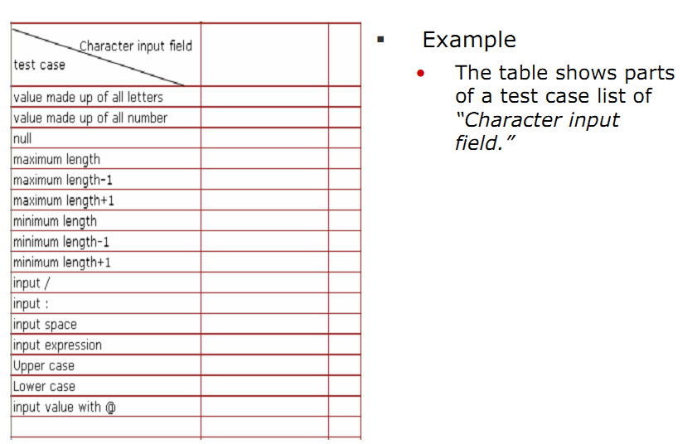
Test Case List

Slide 17
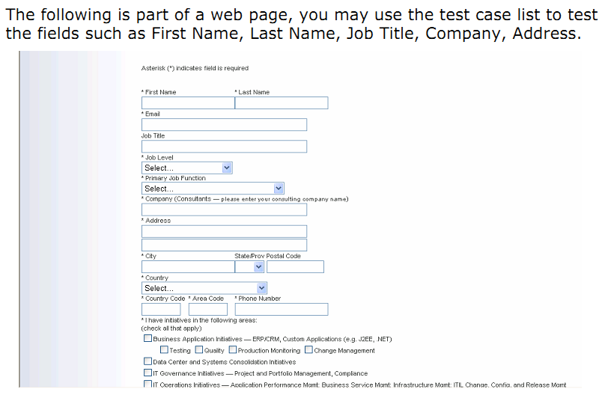
Test Case List

Slide 18
Server Performance and Loading
Server performance and loading
• Web applications may be used by thousands of users at the same time. It is the performance of the server that is critical.
• You may follow the performance testing cycle to test the performance of the web application while paying attention to the following:
1. Build test environment as closely as possible to the deployment environment on the user side.
2. Developing correct user scenarios. Testing with incorrect scenarios means nothing.
3. The performance of a server’s processor, disk and memory will greatly affect the performance of the application.
4. There lies tolerance between tested performances and performances in reality

Slide 19
Configuration and Compatibility Testing
Overview
  • One of the most attractive attributes of web applications is that it is released to the whole world and runs on different platforms with different software to interact.
  Configuration and compatibility testing is to test the problem of websites.
 Test cases should be taken into account:
  Design configuration and compatibility testing, by considering what possible hardware and software configurations could affect the operation or appearance of the site.
  Hardware platform
  Can the website work correctly and display properly on different kinds of hardware such as PC, PDA or mobiles ?
  Can the website communicate correctly with software running on the hardware?

Slide 20
Localization Testing
ƒ Points of localization testing
  The localization testing effort focuses on:
    1. Areas affected by localization, such as UI and content.
    2. Culture/locale-specific, language-specific, and region-specific areas.
  In addition, localization testing should include:
    1. Basic functionality tests.
    2. Setup and upgrade tests run in the localized environment.
    3. Plan application and hardware compatibility tests according to the product's target region.

Slide 21
Configuration and Compatibility
Testing
Test cases should be taken into account.
  2. Browser software and versions
  Can the website work correctly and display properly in different a browser and their version?
  Do the features of browsers and their different versions affect the website functions?
  Does the website look correct in different browsers and versions?
  3. Browser plug-ins
  Does the accepted plug-in or extension work correctly?
  4. Browser options
  Does each browser option have potential impact on how the website operates?

Slide 22
Configuration and Compatibility Testing
Test cases should be taken into account.
5. Video resolution and color depth
  Can the website display properly in various resolutions and colors?
  Could your website be used on a mobile system with fewer colors?
  Text size
  What will happen if the user changes the size of the text?
  Could the website be used with very small or very large text?
  What if it is running on a small screen, in a low resolution, with large text?
7. Modem speeds
„ Does your website work well with various modem speeds?

Slide 23
Usability Testing
Overview
  Websites contain a lot of information and is viewed by users around the world. It should be easy to use and understand for the convenience of the user.
ƒ Test cases should be taken into account.
  Besides the ordinary usability testing techniques introduced before, you should take the following into account when it comes to a website:
  1. Do the page elements move properly?
  2. Are the scrolling pages too long?
  3. Are all critical content and navigation options on the top part of the page?
  4. Does the link color remain the same with the website? For example links to previously seen pages should be purple or red and links to unseen pages should be blue.

Slide 24
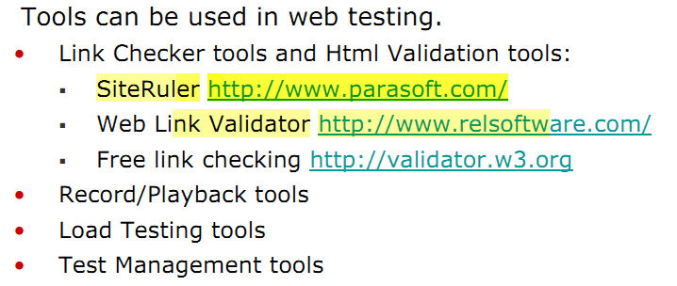
Web Testing Tools

Slide 25
